Slide 1
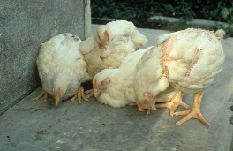
poultry diseases 1 (xpkkoju)
fourth stage
شعار الكلية
يمكن اضافة صورة تتلائم مع اسم المادة
chapter one – Nutritional Deficiency Diseases- lecture 2
Vitamin E
Dr.Harith Abdulla
Department of Pathology and Poultry Disease
College of veterinary medicine university of basrah
University of Basrah- College of veterinary medicine- Department of Pathology and Poultry Disease

Slide 2
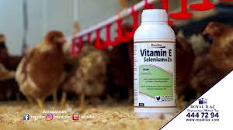
Vitamin E
Is a powerful antioxidant and important for normal neurological functions. Deficiency leads to encephalomalacia/crazy chick disease, exudative diathesis in young birds, muscular dystrophy seen more frequently in older and mature birds

Slide 3
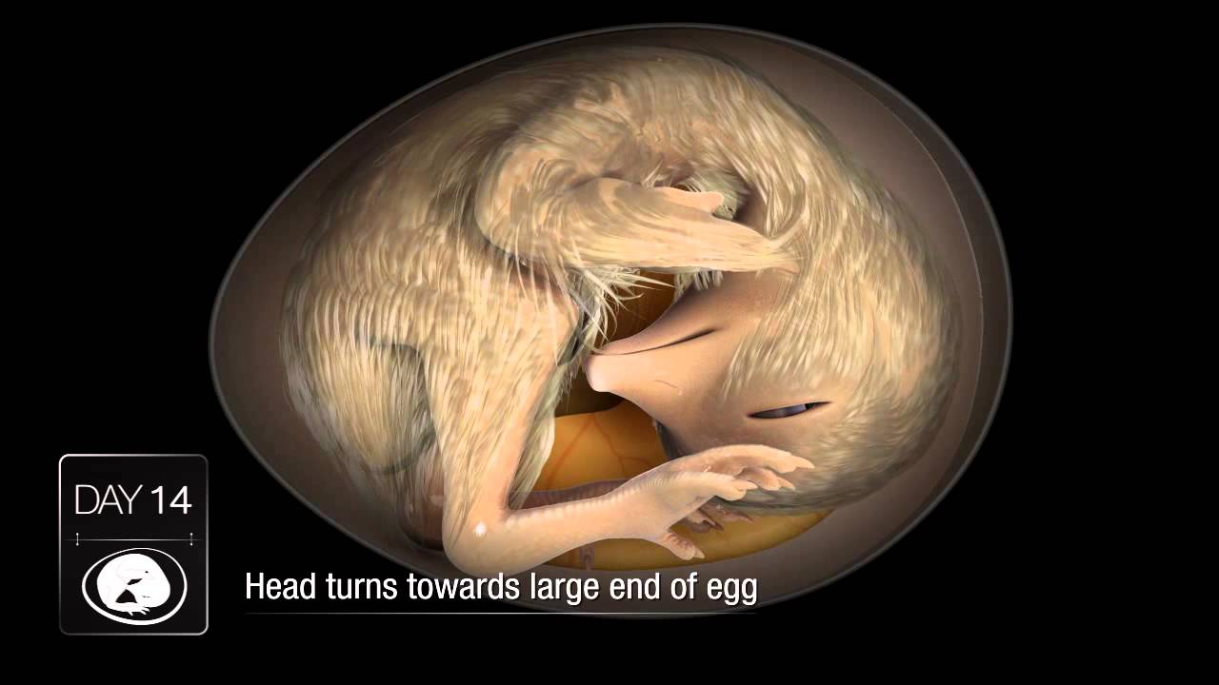
Vitamin E Deficiency
Symptoms:
1-In Adult ( Mature )
a-Early embryo mortality.
b-Testicular degeneration in males.
2- In Chicks ( Young ) :
There are 3 disease conditions can be seen in
chicks due to vitamin E deficiency .

Slide 4
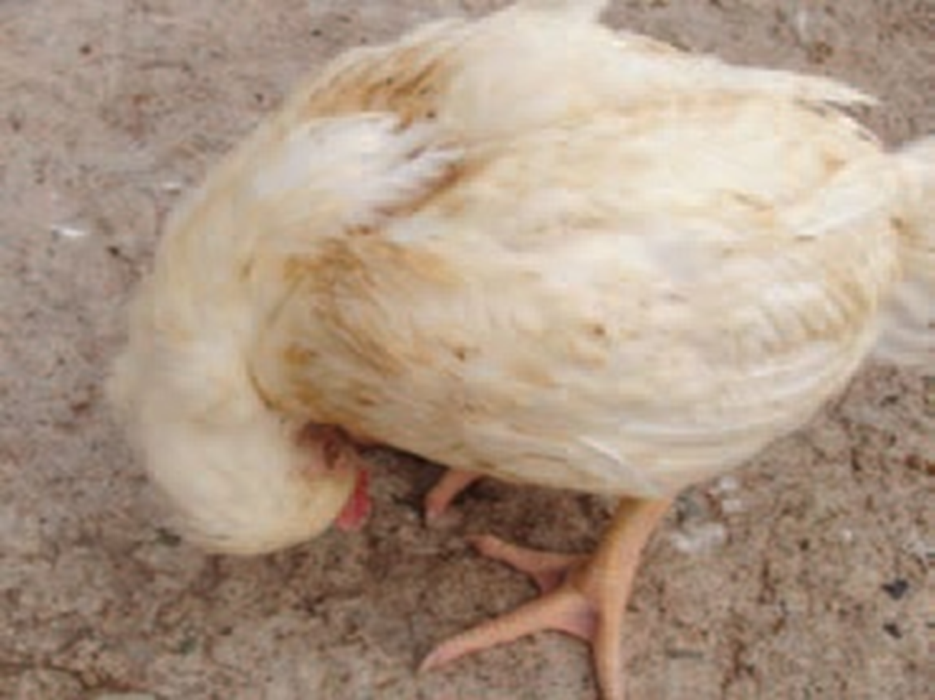
a-Encephalomalacia(Crazy Chick Disease).
Encephalomalacia is a nervous syndrome characterized by
1-Ataxia, backward or downward retraction of
the head, sometimes with lateral twisting .
Increasing incoordination, rapid contraction
and relaxation of the legs and finally complete
prostration and death.
2- The deficiency
usually manifests
itself between day
15 and 30 of the
chick’s life.

Slide 5
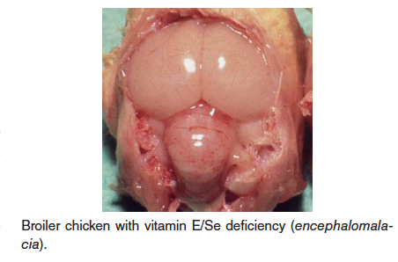
Post-mortem lesions :
1-Soft and swollen brain.
2-Minute hemorrhages on the surface of the brain.
3-Greenish-yellow necrotic areas.
Microscopically :
1-Edema.
2-Capillary
hemorrhages.
3-Thrombosis.
4-Necrosis.

Slide 6
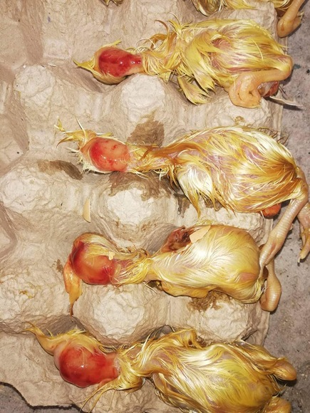
b- Exudative Diathesis :
1-Edema of the Subcutaneous
tissue associated with abnormal
permeability of the capillary
walls, produces greenish blue and
viscous fluid under the skin of
the abdomen
( due to specific gravity ).
2-Anemia.
3- In severe cases, chicks stand with their legs far apart as a result of accumulation of fluid under theventral skin.

Slide 7
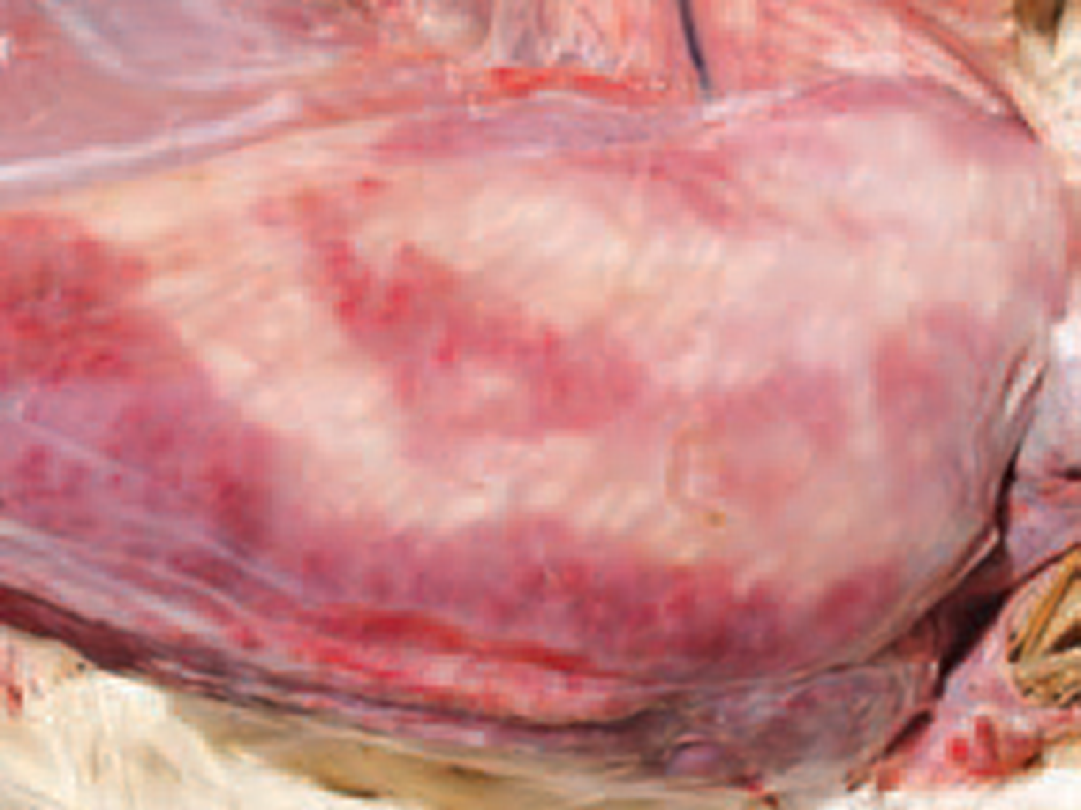
C- Nutritional Myopathy (Muscular Dystrophy)
When vitamin E deficiency
is accompanied by a
sulfur amino acid deficiency,
chicks show signs of nutritional myopathy :
Light colored streaks of muscle fibers in the
breast.
Histological examination:
1- Edema. 2- Hyaline degeneration.

Slide 8
Exudative Diathesis: Greenish fluid under the skin

Slide 9
Treatment of vitamin E deficiency:
Exudative diathesis and muscular dystrophy ,
if not too advanced , are treated by administration of vitamin E.
Encephalomalacia may or may not respond to
treatment.

Slide 10
Character | Vitamin E Deficiency | Avian Encephalomyelitis | Newcastle Disease
Head Tremor | Slight | + + | + -
Respiratory signs | _ | _ | +
Swollen brain | + | _ | _
Air sac infection | _ | _ | +

Slide 11
Vitamin D
Functions of vitamin D:
Vitamin D is required by poultry for
1. Proper metabolism of calcium and phosphorus.
2.Formation of the normal bony skeletal.
3. Hard beaks and claws .
4. Strong egg shells.

Slide 12
.
Al so Vitamin D is necessary in the regulation of calcium metabolism by stimulating the intestinal absorption of calcium, influencing osteoblast and osteoclast activity, and increasing renal tubular reabsorption of calcium in response to metabolic demands for calcium.

Slide 13
Vitamin D Deficiency
Types:
1-Rickets : In young .
2-Osteomalacia : In adult.

Slide 14
Symptoms:
1-Symptoms start about 2-3 months, after the birds were
deprived of vitamin D ( in adult).
2-Marked increase in the numbers of thin- shelled and soft-
shelled eggs followed by decrease in egg production.
Hatchability is also decrease ( In adult ).
3- Leg weakness * Penguin type squat *
The beak , claws and keel bone become very soft and pliable
( In young and adult ).
4-Inward curve of the ribs ( In young and adult ).
5- Feathering is usually poor, and an abnormal banding of feathers may be seen in colored breeds.

Slide 15
Post –mortem lesions :
A- In Adult:
1-Bones are soft and break easily.
2-Well defined knobs are seen on the inner
surface of the ribs.
3-Swollen hocks.

Slide 16
B-In Chicks(Young ):
Beading of the ribs at their juncture with the
spinal column and bending of the ribs
downward and posteriorly .
Treatment:
Feeding of a single massive dose of
vitamin D3.

